Slide 1
Coronary Endarterectomy
Muditha Lansakara
National Hospital
Kandy
Sri Lanka

Slide 2
Outline
Introduction
What is endarterectomy
Guidelines
Techniques of endarterectomy
Advantages and disadvantages
evidence

Slide 3
JTCVS Techniques c Volume 10, Number C 133
Mario Gaudino, MD, PhD – guest editor

Slide 4
“Coronary thromboendarterectomy represents one of the most technically challenging procedures for the coronary surgeon. Although in most cases, careful selection of the anastomotic site (eventually with the help of intraoperative imaging) may avoid the need for endarterectomy, there are patients and target vessels for which the surgeon's expertise with the procedure makes the difference between a suboptimal operation and a good result that will benefit the patients for the years to come. As is often the case in surgery, attention to details is key,”

Slide 5
An action which I do not like to perform during CABG but I have to perform when necessary
Going against physiological principles
controversial topic

Slide 6
The three factors of Virchow's triad
intravascular vessel wall damage
stasis of flow
the presence of a hypercoagulable state

Slide 7
Demography for coronary artery disease and CABG
Coronary artery disease (CAD) is the leading cause of morbidity and mortality worldwide and is responsible for approximately 20% of all deaths in the United States.
Approximately 1.5 million Americans have an acute myocardial infarction (AMI) annually, of which one-third result in death

Slide 8
Coronary stenting/CABG guidelines –

Slide 11
What is endarterectomy?
Removal atherosclerotic plaque from an artery along with the endothelium and part of the media

Slide 12
Since the introduction of drug-eluting stents (DES), the indication for percutaneous coronary intervention (PCI) has been expanded to multivessel and left main diseases, for which CABG was conventionally indicated
This trend accelerated remarkably after the emergence of second-generation DES. Thereafter, the number of CABG procedures has been decreasing, and the complexity of coronary artery disease (CAD) referred for CABG has been increasing.

Slide 15
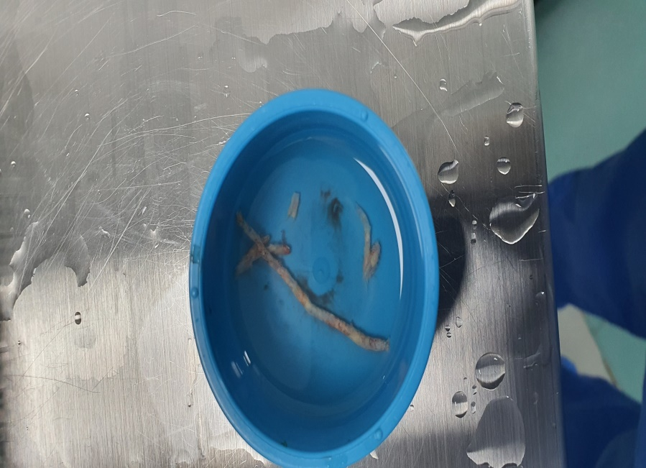
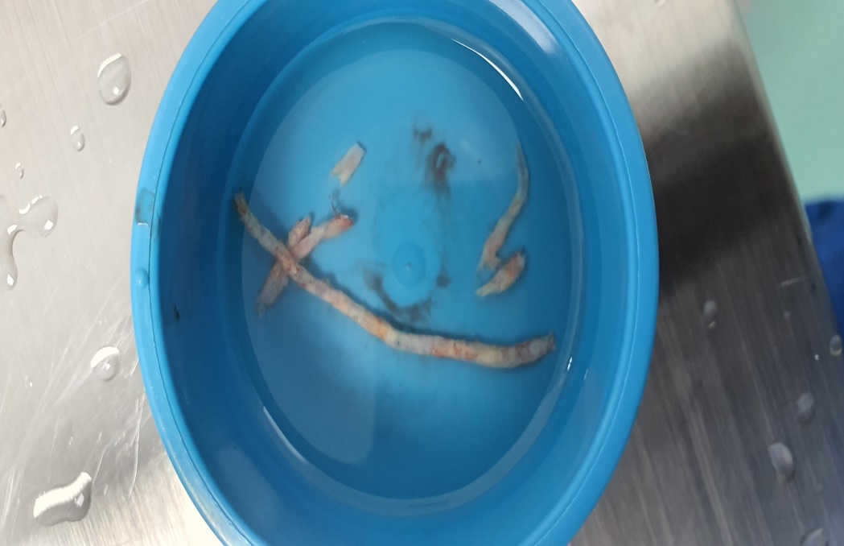

Slide 16
History of endarterectomy
May performed the first experimental closed, retrograde endarterectomies on dog and cadaver coronary arteries using a special catheter to extract atheroma.
In addition, Charles Bailey soon performed the first closed coronary endarterectomy on a human subject on October 29, 1956, at Hahnemann Hospital in Philadelphia, using a retrograde, distal, blind technique without heart-lung bypass.
(Ann Thorac Surg 1997;63:869 –78) © 1997 by The Society of Thoracic Surgeons

Slide 17
However, initially many cardiac surgeons were reluctant to perform this procedure, because the patients
who underwent CE were at higher risk of surgical morbidity, such as perioperative myocardial infarction
(POMI), and mortality.
Moreover, coronary artery bypass grafting (CABG) was introduced in the late 1960s and rapidly became the
gold standard for surgical coronary revascularization.
Therefore, CE is a historical and unfamiliar procedure for most modern cardiac surgeons.

Slide 18
What do we need- instruments ?

Slide 19
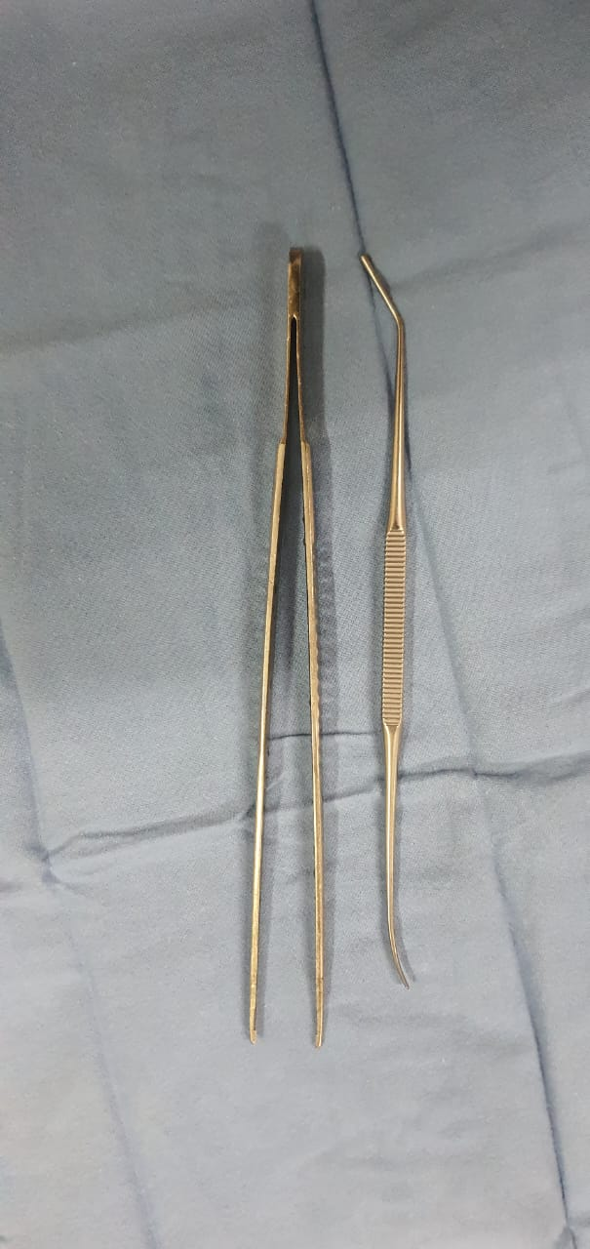

Slide 20
Techniques - closed ( traction) vs open (direct vision)

Slide 22
Lots of papers support open technique

Slide 23
On pump or Off pump?
STS data base 88.5% on pump

Slide 27
CE-CABG remains rare in current practice, performed in only 2.89% (32 164/1 111 792) of all isolated CABG cases from July 2011 to September 2019 in the STS ACSD.
Compared with CABG alone, CE-CABG was associated with increased rates of operative mortality (3.2% vs 1.7%; P < .0001; OR, 1.81; 95% CI, 1.63-2.01) and postoperative MI (6.8% vs 3.9%; P < .0001; OR, 1.80; 95% CI, 1.68-1.93).
long-term survival was similar after the first year, and readmission for MI was comparable after the third year. The 5-year survival of CE-CABG in our analysis by Kaplan-Meier estimate was 77%,

Slide 28
 | 2022 |  | 2023
Total No of CABG | 168 |  | 137
No of pts Endarterectomy | 41 | 24.40% (41/168) | 26 | 18.97% (26/137)
Total No endarterectomies | 61 |  | 31
Notes:
Endarterectomy is some times helpful

Slide 29
YEAR | VESSEL | NO OF GRAFTS
2022 | LAD | 18
 | PDA | 17
 | OM1 | 09
 | OM2 | 05
 | RCA | 02
 | D1 | 06
 | D2 | 02
 | PLV | 02
Total Grafts |  | 61
Total Patients |  | 41

Slide 31
Disadvantages of endarterectomy

Slide 32
Re-endothelialisation

Slide 33
Anti-coagulation strategy
To date, there are no definitive guidelines or protocols for postoperative antiplatelet or anticoagulation treatment for patients who have undergone CE
Medications including dual antiplatelets and vit k antagonists
How long?
Dual antiplatelets how long?

Slide 34
Myers and colleagues reported that medication administered postoperatively (warfarin or
clopidogrel) did not significantly affect late mortality after extensive LAD endarterectomy.
Similarly, Russo and colleagues reported that in patients who underwent CE, no significant difference in
midterm clinical outcomes was observed between those treated with single- versus dualplatelet Therapy
However, because angiographic analyses were not performed in both studies, the impact of postoperative
antiplatelet/anticoagulation regimen on the patency of reconstructed vessels after CE is still unclear

Slide 35
Conclusion
Simultaneous off-pump coronary artery bypass grafting and endarterectomy is a viable alternative when
there is no other option for adequate revascularization, and can achieve effective medium- and long-term
clinical improvement in these patients, when performed as recommended herein

Slide 36
References:-
Richard L. Mueller, MD, Todd K. Rosengart, MD, and O. Wayne Isom, The History of Surgery for Ischemic Heart Disease, The Society of Thoracic Surgeons, Ann Thorac Surg 1997;63:869 –78.
Nikolaos A. Papakonstantinou (MD), Nikolaos G. Baikoussis (MD, PhD), Efstratios Apostolakis (MD, PhD) , Coronary endarterectomy: New flavors from old recipes a General Surgery Department. Journal of Cardiology 63 (2014) 397–401.
John J. Kelly, MD, Jason J. Han, MD, Nimesh D. Desai, et.al, Coronary Endarterectomy: Analysis of The Society of Thoracic Surgeons Adult Cardiac Surgery Database Division of Cardiovascular Surgery, University of Pennsylvania, Philadelphia, Pennsylvania; Ann Thorac Surg 2022;114:667-75.
Guillermo Careaga Reyna, David Salazar Garrido, Sergio Téllez Luna and Rubén Argüero Sánchez, Coronary Endarterectomy and Bypass Grafting without Cardiopulmonary Bypass División de Cirugía Cardiotorácica, Hospital de Cardiología, Centro Médico Nacional Siglo XXI,IMSS, Mexico D.F., Mexico. Rev Esp Cardiol 2003;56(5):515-8
Kosaku Nishigawa, Toshihiro Fukui, Jun Takaki, and Shuichiro Takanashi, Coronary endarterectomy for diffusely diseased coronary artery: An ace in the hole in coronary artery surgery. JTCVS Techniques 2021;10:133-7 2666-2507

